Slide 1
Chattogram Division

Slide 2
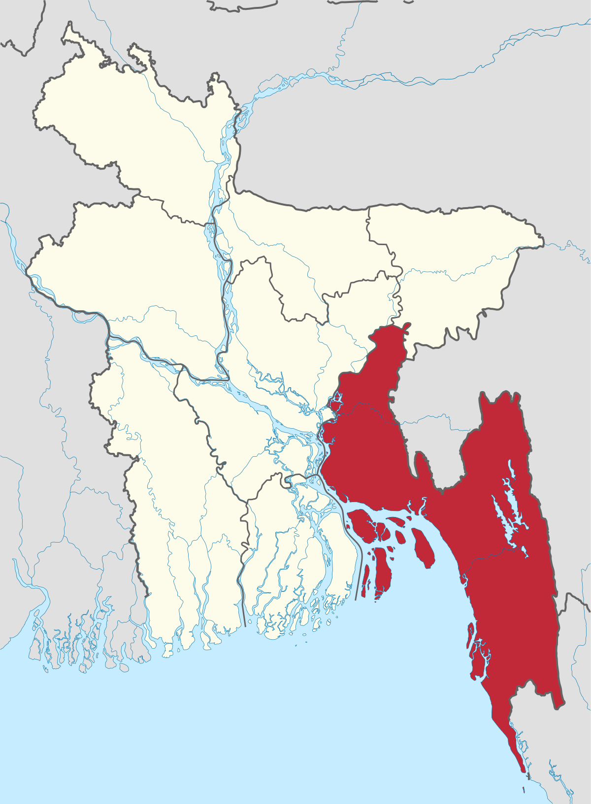
Chattogram Division
Chittagong Division (Officially Chattogram Division) is geographically the largest of the eight administrative divisions of Bangladesh.
Total Area: 33444.03 sq km(Banglapedia) /34,529.97 km2.
The administrative division includes mainland Chittagong District, neighboring districts and the Chittagong Hill Tracts.
The Chittagong Division is an important agricultural area, as well as being a major supplier of hydroelectric power. The city of Chittagong is the country's most important seaport and a vital commercial and industrial center.
There are many lofty hills in Rangamati, Khagrachhari, Bandarban, and the eastern part of Chittagong districts.
Chittagong Division is home to Cox's Bazar, the longest natural sea beach in the world as well as St. Martin's Island, Bangladesh's sole coral reef.

Slide 3
With its rolling green hills, dense forests, cool climate and broad sandy beaches, Chittagong Division, located in the southeasternmost areas of Bangladesh
It is bounded by the Dhaka and Sylhet divisions on the north, the Bay of Bengal and Arakan (Myanmar) on the south, the Mizoram, Tripura, and Chin states of India on the east, and the Dhaka and Barisal divisions on the west.
Chittagong to Dhaka is 265 kilometers (165 miles).
Location:

Slide 4
Administration
Chittagong Division was formed in 1984 with 11 districts as a result of the administrative decentralization.
The greater Sylhet district was separated from the Chittagong Division with the formation of the Sylhet division in
1995.
Chittagong Municipality was established on 27 June 1977; Chittagong City Corporation was formed on 31
July 1990.
Chittagong Division is subdivided into eleven districts (zilas) and then into 99 sub-districts (upazilas).
The districts are:
Chittagong
Cox's Bazar
Rangamati
Bandarban
Khagrachhari
Feni
Lakshmipur
Comilla
Noakhali
Brahmanbaria and
Chandpur.

Slide 5
Administration
Division
Area (sq km) | City corporation | District | Upazila | Paurasabha | Union | Ward | Population |  | Density (per sq km) | Literacy rate (%)
 |  |  |  |  |  |  | Urban | Rural
33444.03 | 1 | 11 | 104 | 59 | 567 | 927 | 6849435 | 21198878 | 838 | 52.7
City Corporation (Census 2001)
City Corporation | Metropolitan Thana | Ward and Union | Mahalla and Mouza
1 | 12 | 41 | 207

Slide 6
Demography
Population Total 28048313; Male 13751764, Female 14296549; Muslim 25132573, Hindu 1982650, Buddhist 842248, Christian 63363 and others 27479. (Banglapedia)
According to the 2022 Census of Bangladesh, Chittagong Division had a population of 33,202,326, 33.7% of whom lived in urban areas. The population density was 979 people per km2. 90.11% were Muslims, 6.61% Hindus, 2.92% Buddhists, 0.22% Christians and 0.14% others. (Wikipedia)
Main City: Chittagong
Population: 23,999,345
Literacy rate: 32.08%
https://www.amardesh.com/division_chittagong.php

Slide 7
Chittagong or Chattogram District/City
A bustling city, the capital of Chittagong Division, and the 2nd largest city in the country.
Chittagong District area 5282.92 sq km, is bounded by khagrachhari and Rangamati districts and Tripura state of India on the north, cox's bazar district on the south, bandar ban, Rangamati and Khagrachhari districts on the east and Noakhali district and the bay of Bengal on the west. Chittagong District is quite different from other districts for its unique natural beauty characterized by hills, rivers, sea, forests and valleys.
Home to the Port of Chittagong, it is the busiest port in Bangladesh and the Bay of Bengal. The city is also the business capital of Bangladesh.
The city is located on the banks of the Karnaphuli River between the Chittagong Hill Tracts and the Bay of Bengal.
The Greater Chittagong Area had a population of more than 140 million in 2022.
In 2022, the Chittagong District had a population of approximately 9.2 million.
In 2022, the city area had a population of more than 5.6 million.
The city is home to many large local businesses and plays an important role in the Bangladeshi economy.

Slide 8

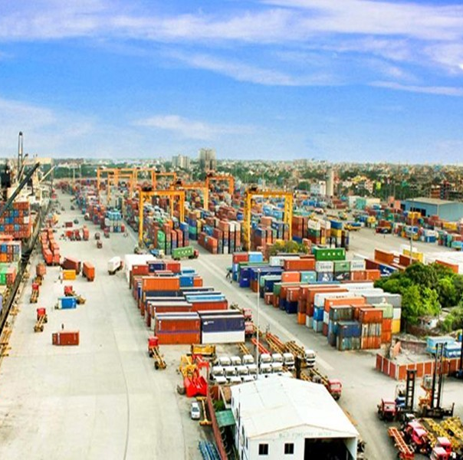
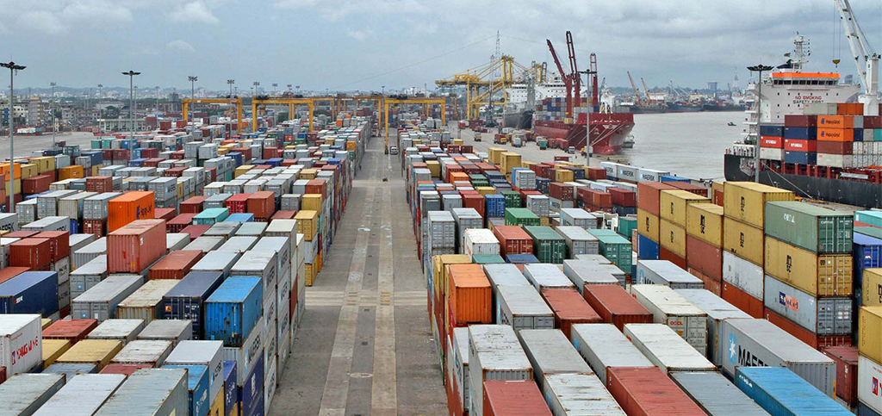
THE PORT CITY:CHITTAGONG
Chittagong Port Authority is a government agency of Bangladesh responsible for the management, maintenance and governance of the country's major port of Chittagong. It located in the city of Chittagong on the Karnaphuli River nine nautical miles from the shore of the Bay of Bengal of the Indian Ocean. The CPA is part of the Ministry of Shipping.
The first Export Processing Zone (EPZ) of Bangladesh, established in 1983, is situated here. Chittagong Municipality was formed in 22 June 1863. It was turned into Chittagong City Corporation on 31 July 1990.

Slide 9
Historical Background
Ancient: Stone Age fossils and tools unearthed in the region indicate that Chittagong has been inhabited since Neolithic times. It is an ancient port city, with a recorded history dating back to the 4th century BC.
The Arab traders had business transactions with this port since 9th century AD. Chittagong region was under the kingdom of Arakan during sixth and seventh centuries. Before the Muslim rule Chittagong had been either under the control of the Arakan's or under the kings of Burma.
Medieval: Arab Muslims (and later Persians too) frequented Chittagong for trade since the 9th century.
In the Fourteenth Century, explorer Ibn Battuta passed through Chattogram during his travels.
Sultan Fakruddin Mubarak Shah (1338-1349) of Sonargaon conquered Chittagong in 1340.
Portuguese: ships from Goa and Malacca began frequenting the port city in the 16th century. The cartaz system was introduced and required all ships in the area to purchase naval trading licenses from the Portuguese settlement.
Mughal-Arakanese battle on the Karnaphuli River in 1666.
The Mughals renamed Chittagong as Islamabad.
In 1971, during the Bangladesh Liberation War, Chattogram suffered massive losses in people and buildings given that they denied the Pakistani army access to the port.

Slide 10
Names of Chittagong/Chattogram
The etymology of Chittagong is uncertain. Historians have given various explanations as to the origin of the name Chittagong. The port city has been known by various names in history, including Chatigaon, Chatigam, Chattagrama, Islamabad, Chattala, Chaityabhumi and Porto Grande De Bengala.
The Bengali word for Chittagong, Chattogram, has the suffix- "Chatto" (চট্ট/আদর্শ) "Gram" (গ্রাম) meaning village in Standard Bengali.
The earliest records, before Islam reached the region, state that it was a place of chaitya or Buddhist monasteries. The city had a very large Buddhist population before Islam.
The Burmese tradition of the city's etymology, is that an Arakanese king, invading in the 9th century, gave the city the name Tsit-ta-gung (to make war is improper)
One explanation credits the first Arab traders for shatt ghangh (Arabic: شط غنغ) where shatt means "Delta" and ghangh stood for the Ganges.
The Portuguese referred to the port city as Porto Grande de Bengala, which meant "the Grand Harbor of Bengal". The term was often simplified as Porto Grande.
The city was renamed Islamabad (City of Islam) during the Mughal era. The name continues to be used in the old city. In April 2018, the Cabinet Division of the Government of Bangladesh decided to change the city's name to Chattogram.

Slide 11
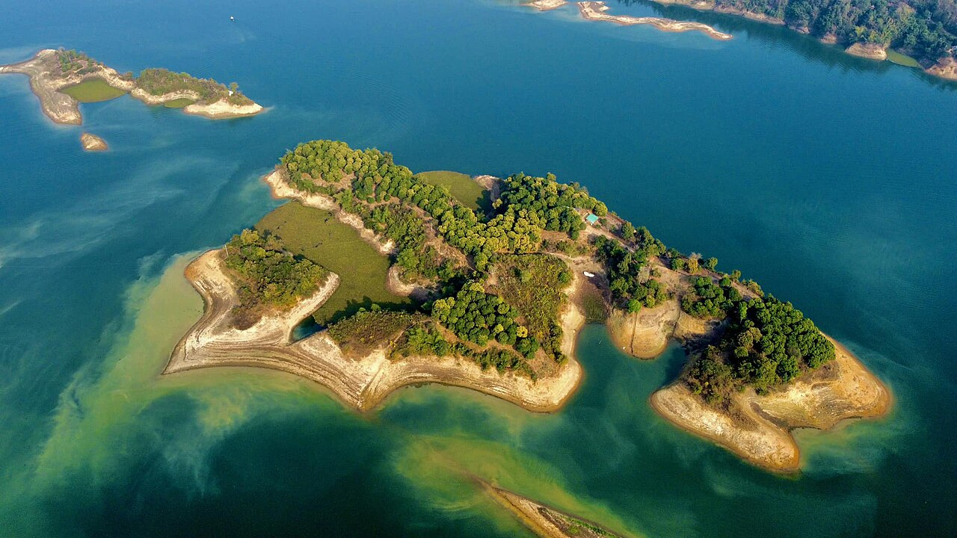
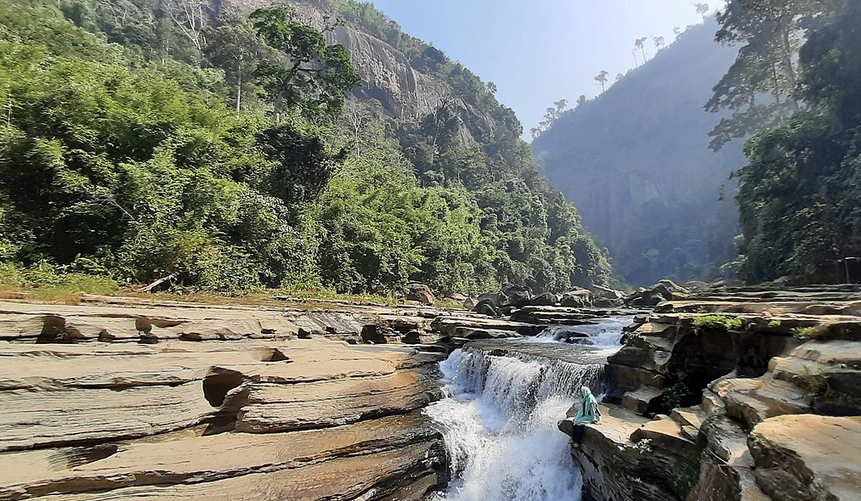
Chittagong Hill Tracts
The Chittagong Hill Tracts, often shortened to simply the Hill Tracts and abbreviated to CHT, refers to the three hilly districts within the Chittagong Division in southeastern Bangladesh, bordering India and Myanmar (Burma) in the east: Khagrachhari, Rangamati, and Bandarban. Covering 13,295 square kilometres (5,133 sq mi), CHT is a extensively hilly area and home to a variety of tribal peoples in Bangladesh. The CHT were divided by the British in the 19th century into three tribal chieftaincies, the Chakma Circle, the Mong Circle and the Bohmong Circle. They formed a single district until 1984, when they were divided into three separate districts.

Slide 12
Location | Indigenous Communities
Chittagong Hill Tracts (Bandarban, Rangamati and Khagrachari district) | Chakma
 | Marma
 | Tripura
 | Bawm
 | Pangkhu
 | Lusai
 | Tanchangya
 | Khiang
 | Mru
 | Asam
 | Gurkha
 | Chak
 | Khum
The Chittagong Hill Tracts not only feature distinct landscapes but also unique indigenous communities. Unlike the majority Bengali population, the region is home to diverse Adivasi groups of Mongoloid origin, inhabiting Rangamati, Bandarban, and Khagrachhari.
The culture of this tribal people is also very colorful. The greatest cultural festival of these people is the "Baisabi utsab". In Chittagong hill tracts all the tribal communities celebrate the festival in the same way. The only difference is the name. The Chakma calls it 'Biju’, the Tanchangya calls it Bishu, the Tripura calls it 'Baisu' and the Marma 'Sangrai' and the first 2-3 words of all the three names form the word 'Baisabi'. They celebrate the day from April 12 to 14 to say goodbye to the outgoing Bangla year and to welcome the New Year.
In Chittagong Hill Tracts each tribe has its own dialect, distinctive dress, rites, and rituals. But despite these distinctive features there are strong bonds between them. They are generally peace-loving, honest, and hospitable.

Slide 13
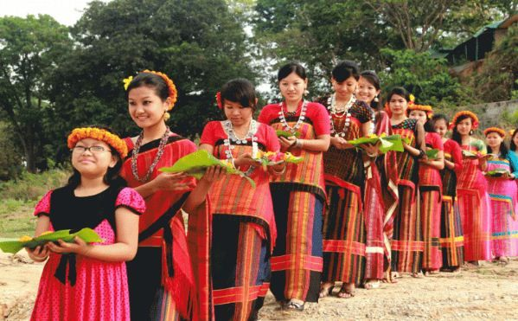
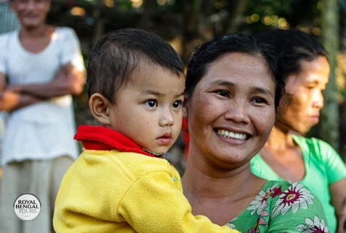
Indigenous Culture
The Chakma are the largest and more than half the combined tribal population in Bangladesh. They are scattered around the three hill districts of Chittagong Hill Tracts (CHT). Buddhism is the most common religion within the tribe. They refer to their tribal chief as Chakma Raja. Chakmas are considered more privileged than most other indigenous Bangladeshi tribes. They have their own language, culture, tradition, and history. Women wear pinon and khadi (handmade) and men wear dhuti. They grow crops via a special eco-friendly method called "Jhum cultivation". They migrated to Bangladesh in the 15th century.
Marmas are the second largest ethnic group in Bangladesh and they are of Burmese (Myanmar) ancestry. The Marmas regarded Burma (Myanmar) as the centre of their cultural life. Historically it is believed that the Arakanese emperor has invaded the south-eastern region of the current Bangladesh. Since then the region was ruled under the Burmese emperor and Marma ethnic groups were established from that period.

Slide 14
Educational Institutions
University : 6 Secondary school 2202
Medical College: 6 Primary school 8786
cadet college: 2 Community school 341
Marine academy 1 kindergarten 65
Technical education college 4 Satellite school 104
Teachers' training college 11 Madrasa 2017
Homeopathy college 7 Nursing institute 5
College 345 Polytechnic institute 6
Law college 9

Slide 15
Notable Educational Institutions
Noted educational institutions: Chittagong University (1966), Chittagong University of Engineering and Technology (1968), Chittagong College,Feni Government College (1922), Sir Asutosh Degree College (1939), Satkania College (1949), Cox's Bazar Government College (1962), Lakshmipur Government College (1964), Chakaria College (1968), Khagrachhari Government College (1974), Comilla Victoria College, Brahmanbaria Government College, Jilani Chisti College, Faridganj Degree College, Haimchar Degree College, Puran Bazar Degree College, Hajiganj Model College, Matlab College, Fulgazi Government College (1972), Sonagazi Government College (1972), Comilla Zila School (1837), Patiya Ideal High School (1845), Noakhali Zila School (1853), Annada Government High School (1875), Chandipur Mansa High School (1924), Bishnupur High School (1925), Feni Model High School (1927), Bandarban Government High School, Ramgarh Government High School (1952), Adampur Fazil Madrasa (1917), Feni Alia Madrasa (1923).'

Slide 16
University of Chittagong
the University of Chittagong is a public University with multidisciplinary faculties situated across a 2110-acre hilly landmass in Fatehpur Union of Hathazari Upazila, 22 kilometres north of Chittagong city of Bangladesh. This university has the largest campus among Bangladeshi universities. The academic activities of the university formally began on 18 November 1966. It has about 24,000 students and more than 1000 faculty members. Area:2110-acre (8.5 km2)
Cumilla University
The Comilla University is a public university located at Kotbari, Comilla, Bangladesh.The university was constructed on 250 acres (100 ha) of land at Shalban Vihara, Moynamoti. Comilla University is affiliated by University Grants Commission, Bangladesh.
Chittagong University of Engineering & Technology(CUET)
Chittagong University of Engineering & Technology commonly referred to as CUET (Bengali: চুয়েট), is a public engineering university in Bangladesh located in Raozan Upazila under Chittagong District. Established in 1968.
Noakhali Science and Technology University(NSTU)
Noakhali Science and Technology University (known as NSTU) is a public university in the coastal terrain Noakhali of Bangladesh. It is the 27th public university (out of 32) and the fifth science and technology university in Bangladesh.
        Rangamati Science and Technology University(RSTU)
Rangamati Science and Technology University is a public university located in Rangamati, Bangladesh.

Slide 17
Chattogram Medical University
Chittagong Medical University is a Government Medical University situated in Chittagong, Bangladesh.
Chittagong Veterinary and Animal Sciences University
Chittagong Veterinary and Animal Sciences University (CVASU) is a public university in Bangladesh. It is the only specialized veterinary university in Bangladesh. It is located at Khulshi, Chittagong.

Slide 18
Important Places
Tourist Spots, Archaeological and Historical Sites

Slide 19
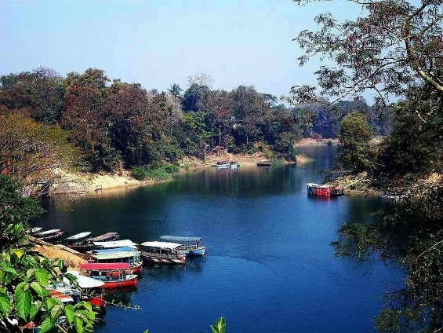
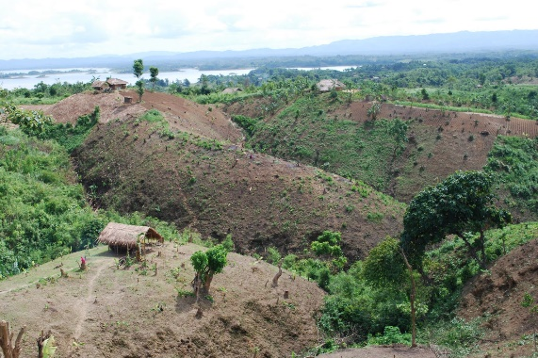
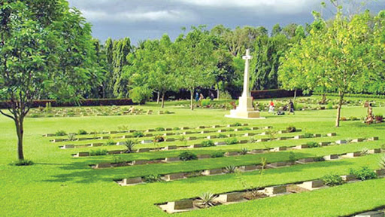
Foy's Lake:
Foy's Lake is a man-made lake in Chittagong, Bangladesh. It was created in 1924 by constructing a dam across the stream that came down from the hills in the northern part of Chittagong.
The purpose of creating an artificial lake was to provide water to the residents of the railway colony. It was named after Mr. Foy, a Railway engineer, believed to materialize said project.
Chittagong War Cemetery:
This cemetery was established to honor Commonwealth soldiers and others who died in World War II.
The cemetery was created by the British Army, and there were originally about 400 burials.
Graves have since been transferred to this cemetery from the Lushai Hills (Assam) and other isolated sites, and from Chittagong Civil Cemetery.
Chittagong War Cemetery is located at Dampara, 19 Badsha Mia Road, 22 kilometers north of the airport and 8 kilometers from the port.
The place which was formerly paddy fields, now then been developed.
Kaptai National Park:
Kaptai National Park is a major national park of Bangladesh situated in Rangamati District.
It was established in 1999 and its area is 5,464.78 hectares (13,498.0 Acres).
Prior to the declaration of the national park, it was Sitapahar Reserve.

Slide 20
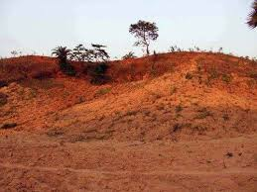
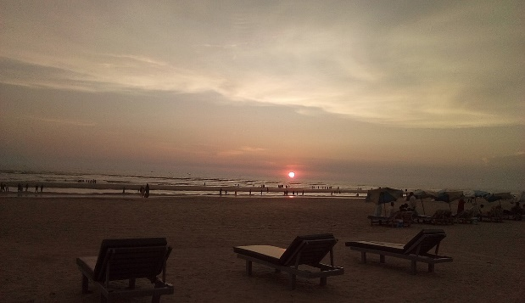
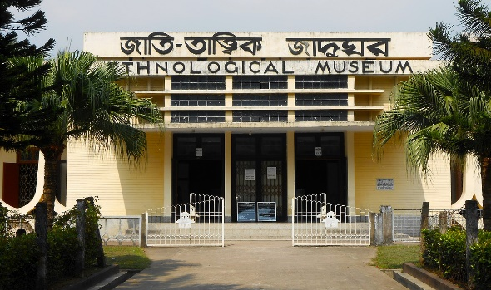
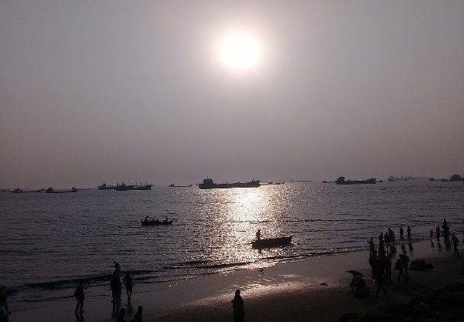
Cox's Bazar Beach:
Cox's Bazar consists of miles of golden sands, towering cliffs, surfing waves, rare conch shells, colorful pagodas, Buddhist temples, and tribes. Having the world's longest unbroken 120 k.m beach sloping gently down to the blue waters of the Bay of Bengal against the picturesque background of a chain of hills covered with deep green forests, Cox's Bazar is one of the most attractive tourist spots in the world.
Lalmai Hills:
Lalmai Hills north-south elongated low hill range of about 17 km long and 1-2.4 km
wide and about 8 km westward from
Comilla. Township is called
the Lalmai-Mainamati hill range.
The northern extremity of the hill
ranges is at Ranir Bungalow
whereas the southern extremity
ends at Chandimura.
The northern part of the hill
range is locally known as Mainamati,
while the southern part is
known as Lalmai.
The name Lalmai is probably derived
from red soil or from the Lalambi forest.
Patenga:
Patenga beach is about 22 km. from Chittagong and is approachable by a motorable road.
On the way to the beach, one passes the Patenga Airport.
Another ideal picnic spot is the Fouzdarhat sea-beach about 16 km. from Chittagong.
Patenga sea beach is one of
the major attractions
of Chittagong for the
tourists. Besides the sea beach,
people can enjoy boating and
river cruise in the
River Karnaphuli.
Ethnological Museum:
The Ethnological Museum of Chittagong is the only ethnological museum in Bangladesh and is located in Agrabad, Chittagong.
The Museum contains displays featuring the history of Bangladesh's tribal people.
The Ethnological Museum was established in 1965 and the museum opened to the public in 1974.

Slide 21
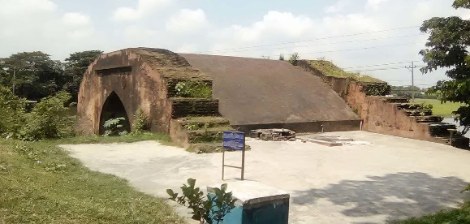
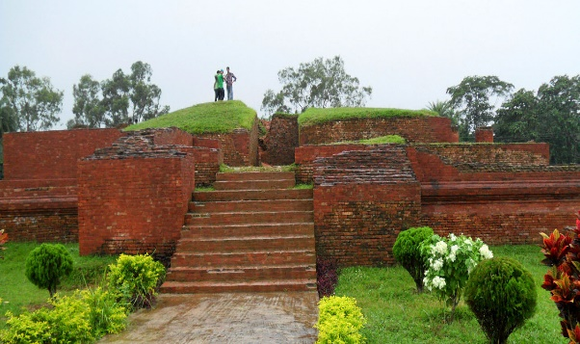
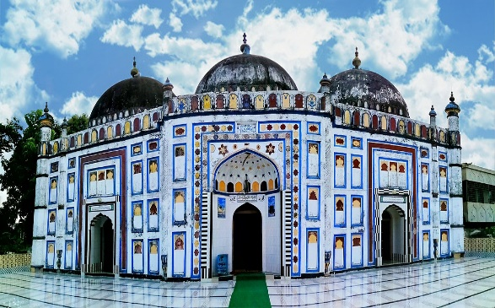
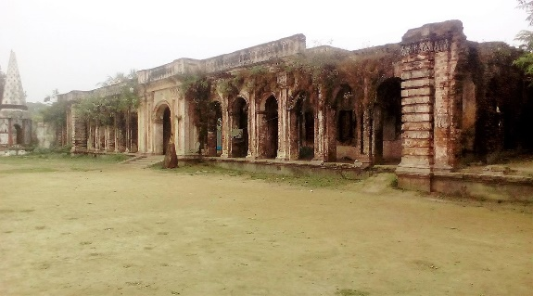
Shalban Bihar
Shalban Bihar is an archaeological site in Moinamoti, Comilla, Bangladesh. The ruins are in the middle of the Lalmai hills ridge, and these are of a 7th-century Paharpur-style Buddhist Bihar with 115 cells for monks.
It operated through the
12th century.
Excavations have
revealed many archaeological
artifacts dated to between the
7th and 12th centuries.
Most of them are kept in the
Moinamoti Museum.
Bariura Old Bridge:
Bariura Old Bridge or Hatirpool is one of the ancient bridges in Sarail Upazila of Brahmanbaria District, and is located 15 kilometres (9.3 mi) north of Brahmanbaria. It was built during Mughal Empire at Bariura, adjacent to the Dhaka-Sylhet highway.
Haripur Barabari:
Haripur Barabari is a palace in Horipur Union of Nasirnagar Upazila at Brahmanbaria district, Bangladesh earlier known as East Bengal.
This palace founded by Jamindar Krishna Prasad Roy Choudhury (1870-1936) in eighteenth century.
Arifile Mosque is in Sarail
Upazila at Brahmanbaria
District, Bangladesh, founded
by Shah Arif in 1662.
Name derived from Arif to
Arifile. Locally known as
Arail Mosque. This is an
example of Mughal architecture, which combined Bengali, Persian, and Islamic influences. Arifile Mosque is located 15 kilometres (9.3 mi) from Brahmanbaria District and 0.5 kilometres (0.31 mi) northwest of Sarail Upazila.

Slide 22
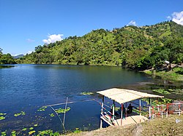
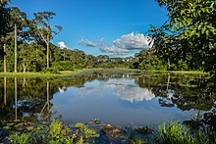
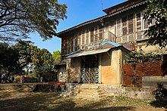
Bogakain Lake:
Bogakain Lake, also called Baga Lake or Boga Lake, is a lake located in Ruma Upazila in the hill district Bandarban, Bangladesh. It is a natural sweet and deep-water lake. Its height from sea level is nearly 1,246 feet (380 m). Geologists believe that it was created by collection of rain water in summer. The lake is irregular in shape.
Dulahazara Safari Park was developed on an undulating landscape of around 2,224 acres (9.00 km2) of area at Chakaria Upazila in Cox's Bazar District, Bangladesh, some 107 km away from the port city, Chittagong, with an objective to create facilities for eco-tourism, research work and entertainment as well as from conserving wild animals in a natural environment. Dulahazara Safari Park is home to at least 4,000 animals of 165 species
Bangladesh Railway Museum:
Bangladesh Railway Museum is the sole railway museum of Bangladesh Railway located in Chattogram, Bangladesh. It was a bungalow before it was turned to a museum on November 15, 2003, which showcases some of the rich collection of relics, objects used in Assam Bengal Railway (1942), Eastern Bengal Railway (1947) and Pakistan Railway (1961).

Slide 23
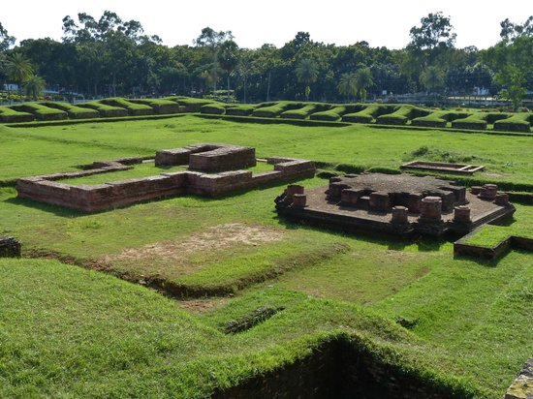
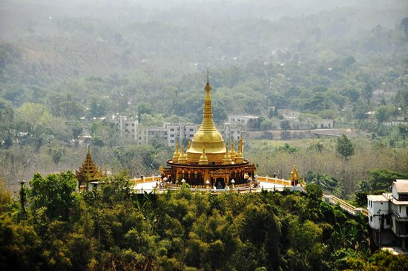
.
The Mainimati Ruins:
The Mainimati Ruins are a selection of
more than fifty scattered Buddhist
sites that enjoy special significance as
a center of Buddhist culture. The
three most important of the various
religious ruins are Salban Vihara, Kotila Mura and Charpatra Mura.
The Buddha Dhatu Jadi:
The Buddha Dhatu Jadi is located close to
Balaghata town, in Bandarban City, in
Bangladesh. Dhatu are the material
remains of a holy person, and in this
temple the relics belong to Buddha. It is the
largest Theravada Buddhist temple in
Bangladesh and has the second-largest Buddha statue in the country.

Slide 24

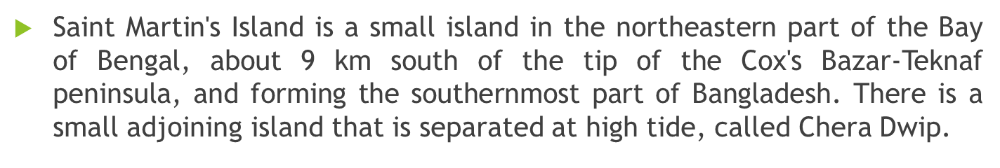
COX’S BAZAR
Cox’s Bazar is a town on the southeast coast of Bangladesh. It’s known for its very long, sandy beachfront, stretching from Sea Beach in the north to Kolatoli Beach in the south. Aggameda Khyang monastery is home to bronze statues and centuries-old Buddhist manuscripts. South of town, the tropical rainforest of Himchari National Park has waterfalls and many birds. North, sea turtles breed on nearby Sonadia Island.
INANI BEACH
Inani Beach is an 18-kilometre-long sea beach in Ukhia Upazila of Cox's Bazar District, Bangladesh. It has a lot of coral stones, which are very sharp. These coral stones look black and green, and they are found in summer or rainy seasons. Pathorkhani is located in Jaliapalong, Inani Beach.

Slide 25
NILACHOL
Nilachol is a wonderful tourist spot which is located at Tigerpara, just 5 km away from Bandarban. The spot is maintained by district administration and locally, it is known as tiger hill. It is near about 2000 feet above of sea level. The entire Bandarban city can be seen at a glance by standing at the peak of Nilachol. Walking through the clouds in the rainy season, feeling fogs in winter, and the beauty of moonlit night, sunset and sunrise attract the tourists a lot.
Sajek Valley
Sajek Valley is a popular tourist spot in Bangladesh, situated among the hills of the Kasalong range of mountains in the northern area of the Chittagong Hill Tracts. Referred to as the "Queen of Hills" and the "Roof of Rangamati", the valley is known for its greenery and dense forests, situated at an elevation of 1,800 feet (550 m) above sea level.

Slide 26
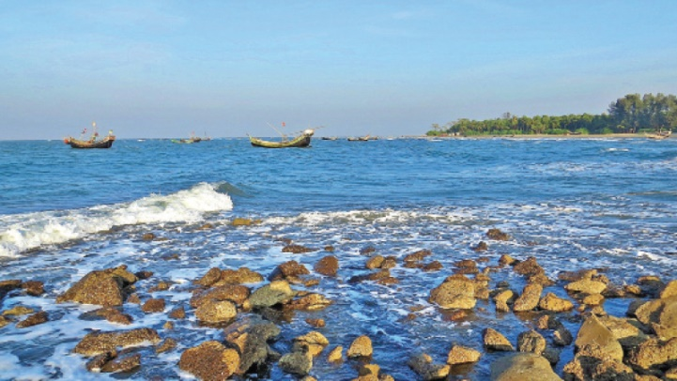

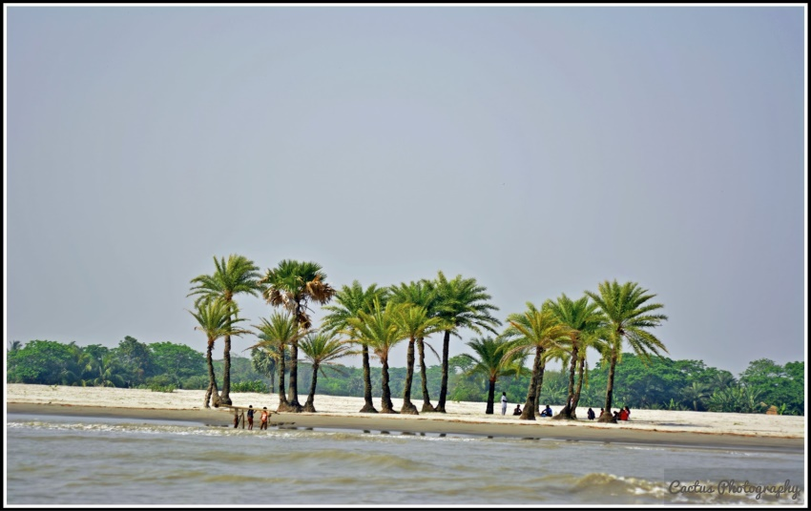
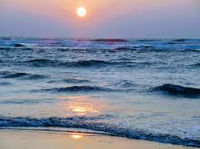
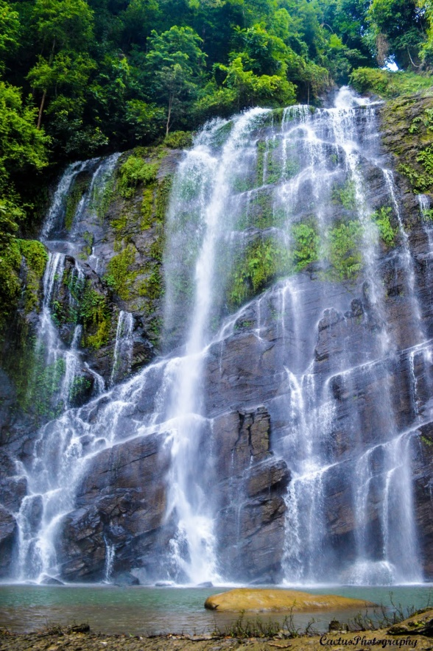
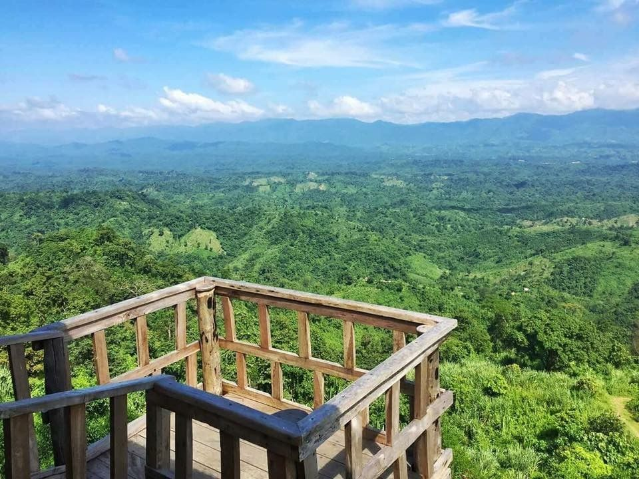
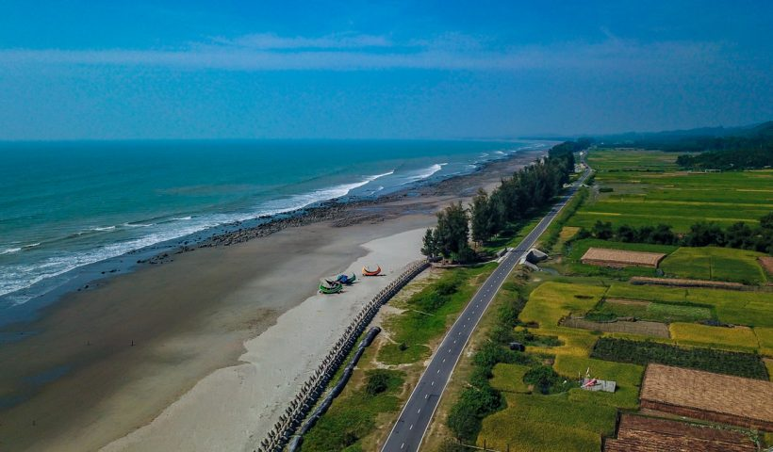
Tourist Places
St. Martin Island
Inani Beach
Nijhum Dwip
Marine Drive
Keokradong
Sajek Valley

Slide 27
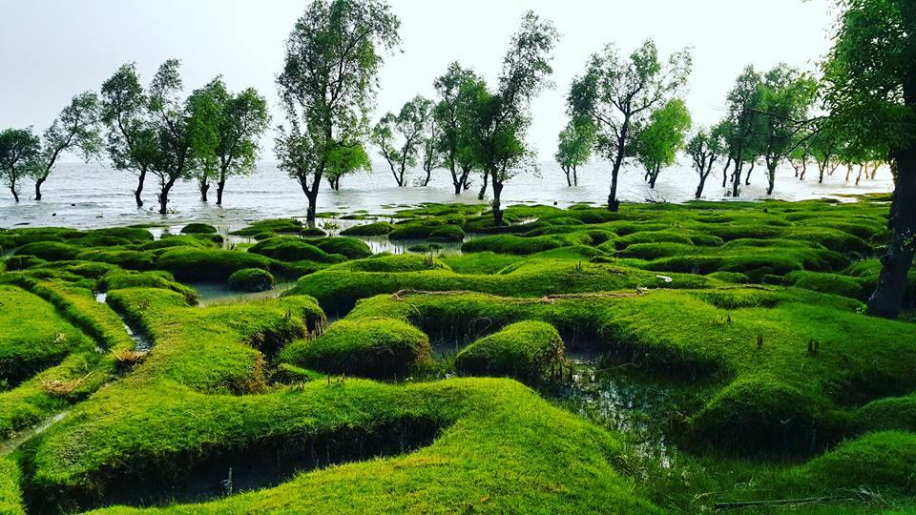
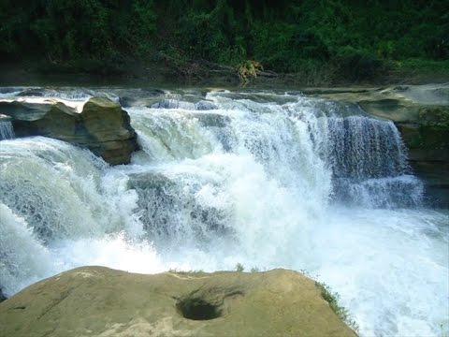
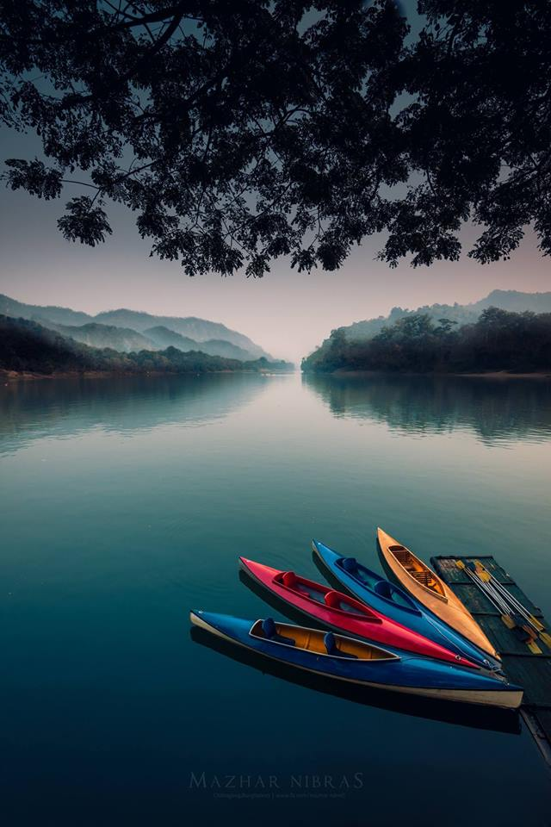
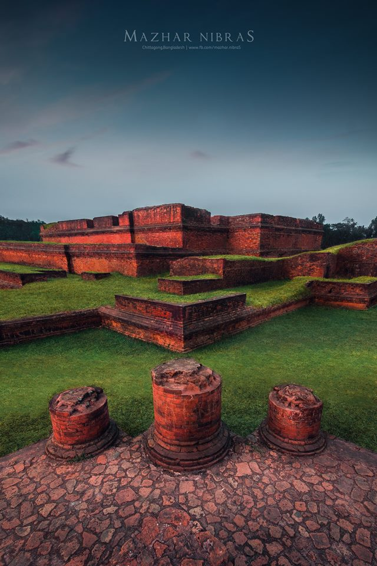
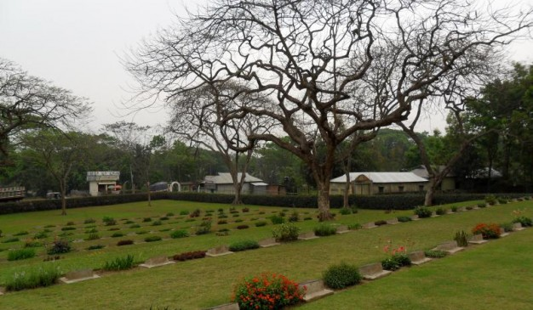
Guliakhali Sea beach
Nafakum
Mainamati War Cemetery
Shalbon Bihar Mainamati
Kaptai Lake

Slide 28
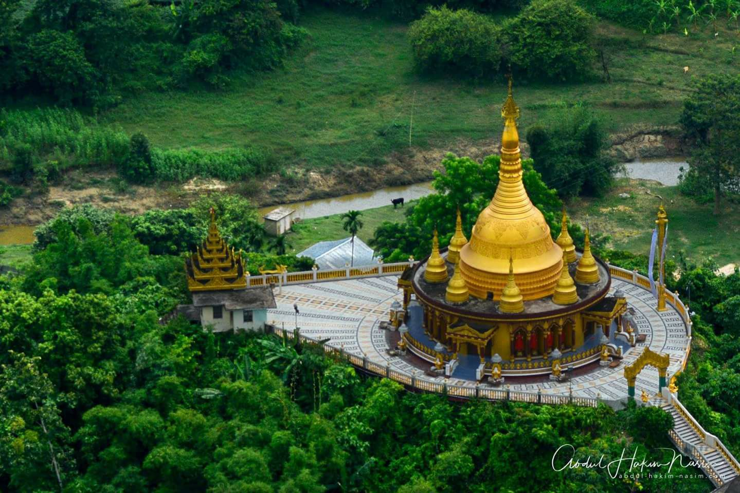
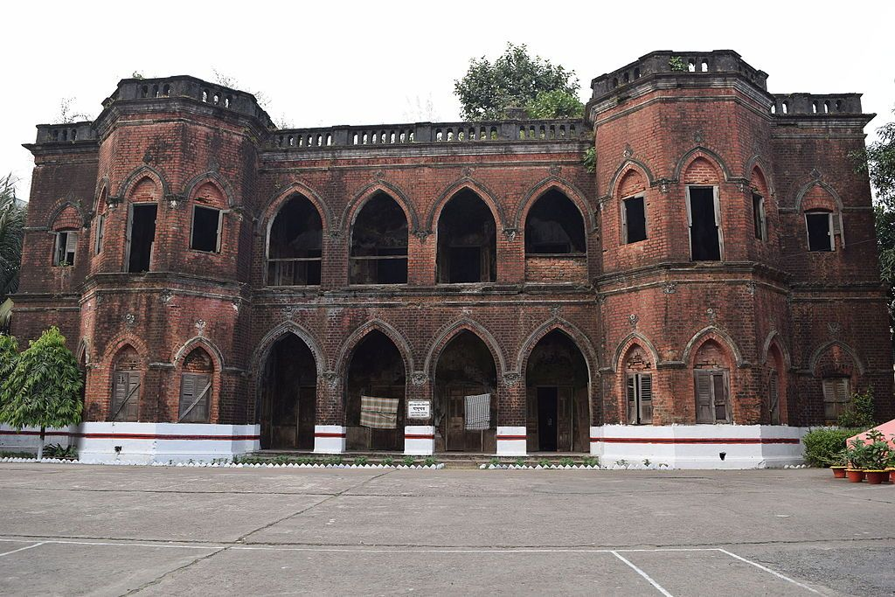
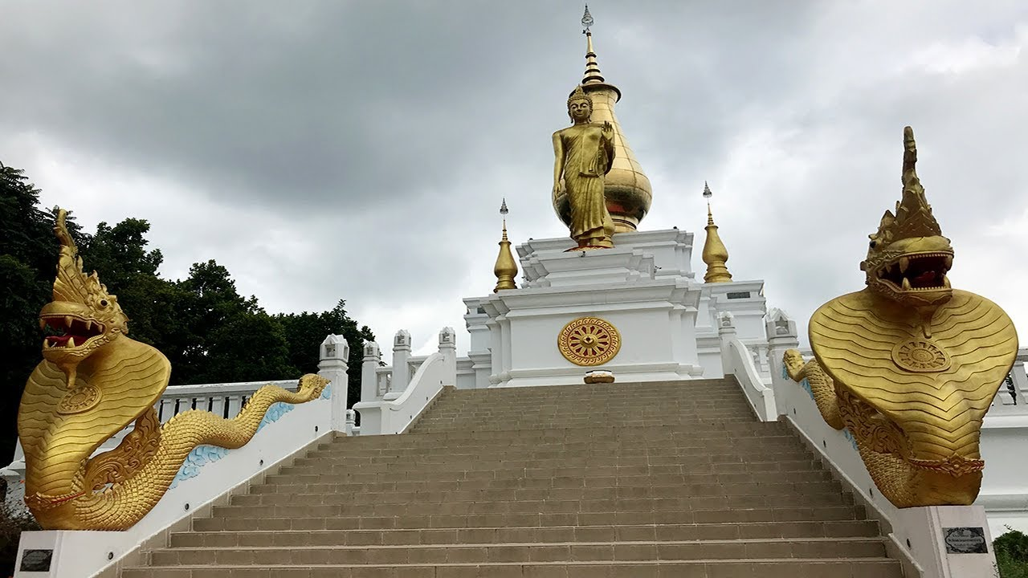
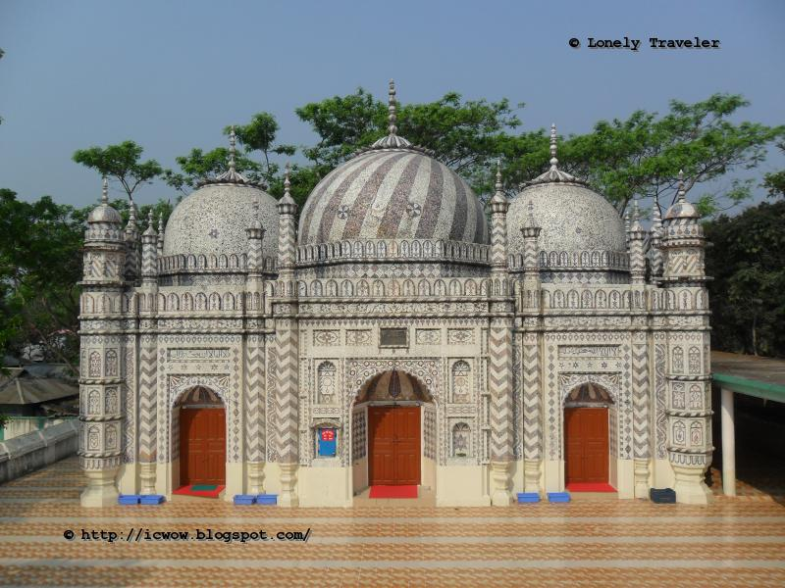
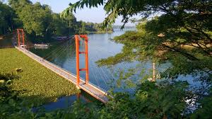
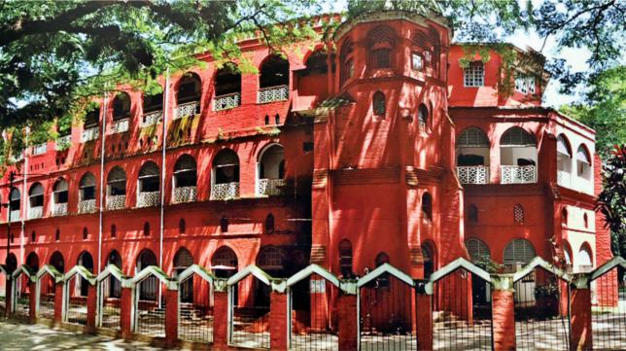
Architectural sites In Chattogram
Abandoned Zamindar palace
Buddhist Temple, Shalbon Bihar
Golden Temple
Bajra Shahi Mosque
Hanging Bridge Rangamati
Chittagong Railway station

Slide 29
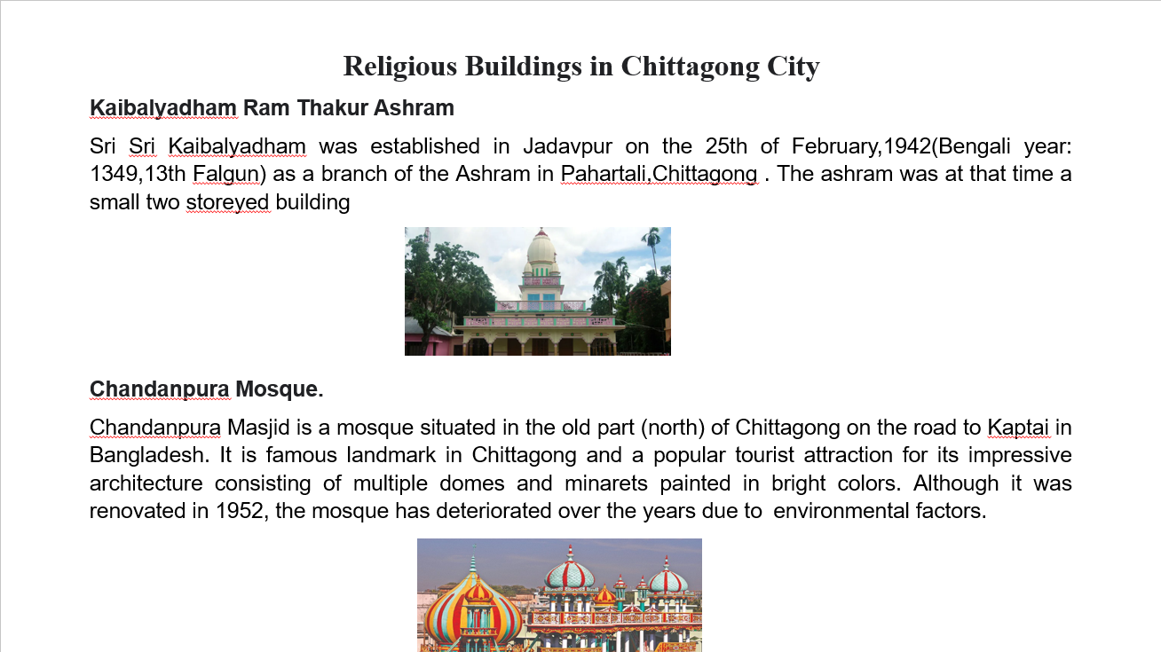

Slide 30
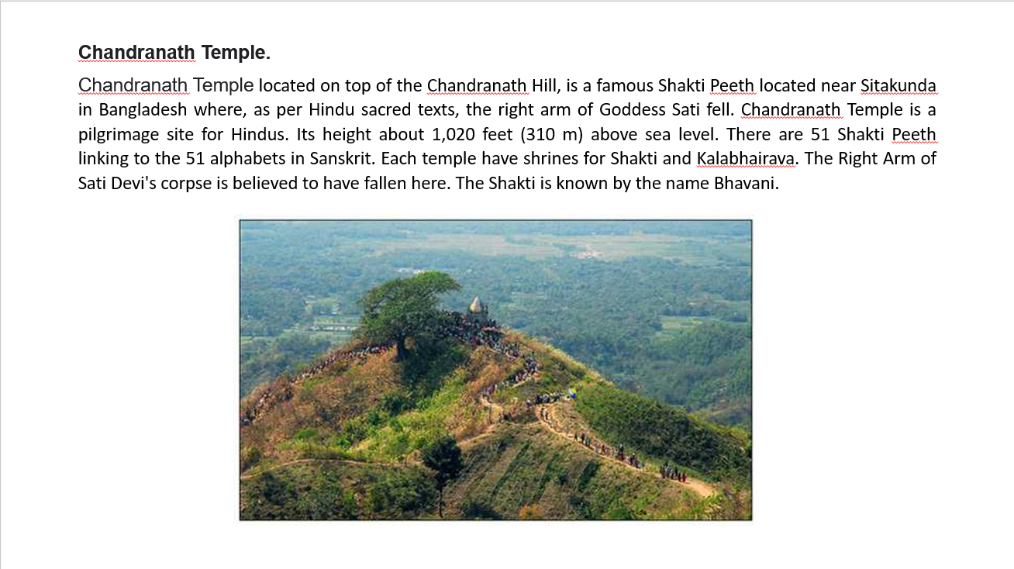

Slide 31
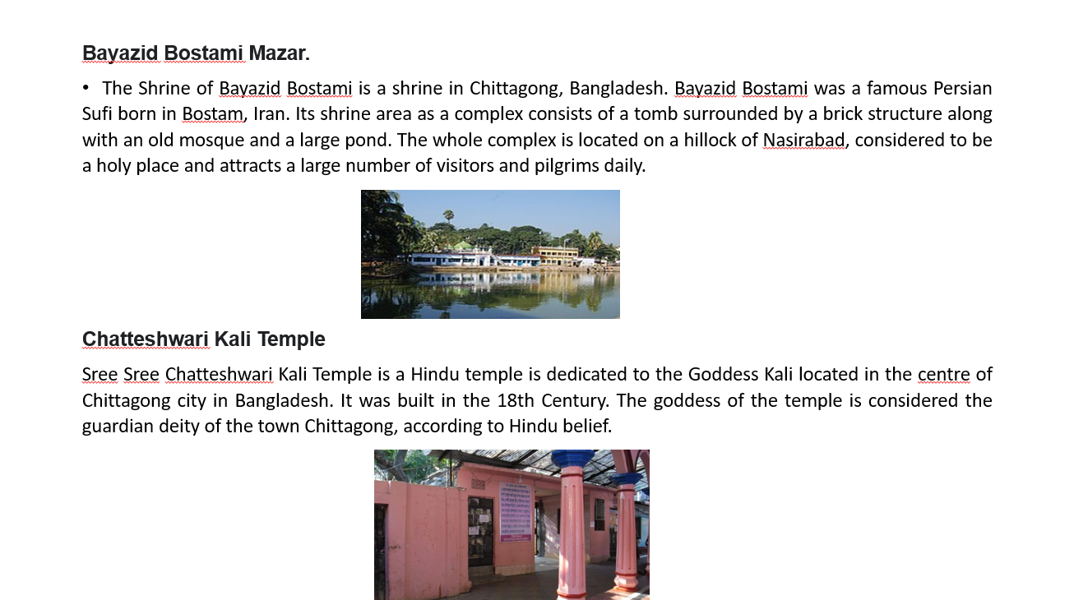

Slide 32
Foods And Traditions of Chittagong

Slide 33
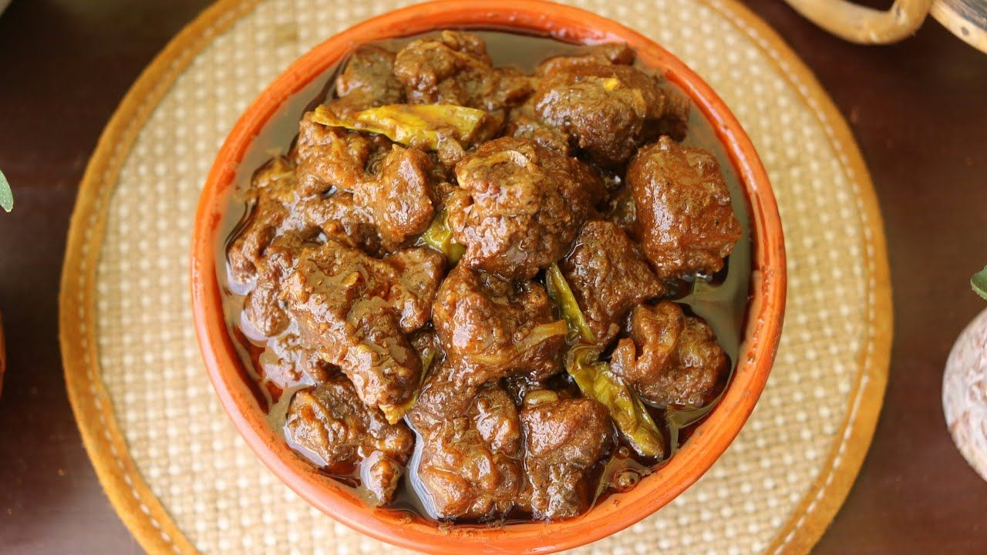
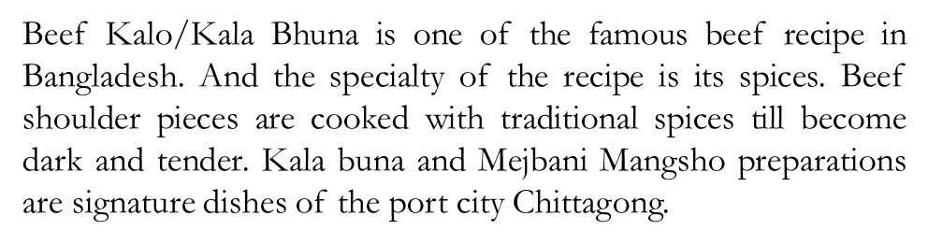
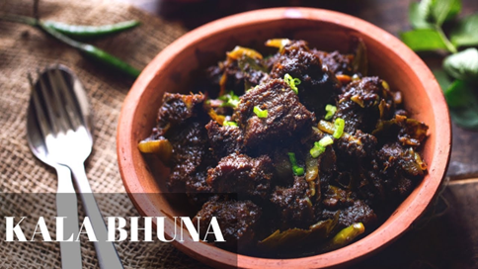
Mejbani Mangsho
The Chittagong region is famous for spicy and hot curries – mainly of beef. Mejbani Gosht is very popular and famous. Mezban is a Persian word literally meaning a host. The word now means 'community feasting', a tradition originating in Dhaka.
Kala Bhuna

Slide 34
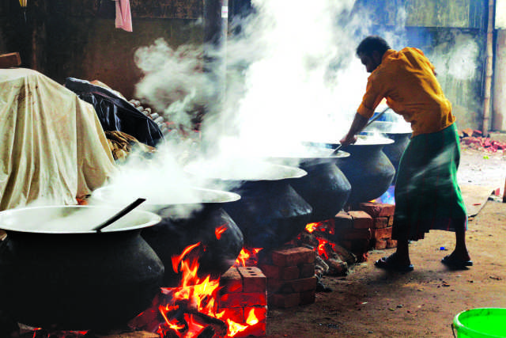
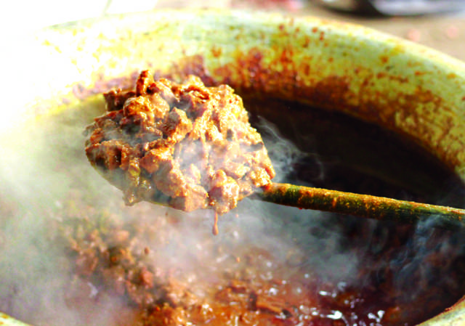
Chittagong food
Mezban: Mezban is the favorite and traditional
food in Chittagong. Mezban(locally known as
Mejjan) is one of the popular social festivals of the
Chittagong region in Bangladesh. The word "Mezban"
in Persian means host and "Mezbani" means hosting
or arranging a feast for the guests. Historically
Mezbani is a traditional regional feast where people are invited to enjoy
a meal with white rice and beef, besides a ton of other dishes, are
also served such as curry of Mung Bean, Liver Fry, etc.
that depends on the event the event was held on
the occasions such as death anniversaries, birth anniversaries,
own successes, launching of a new business, entry into a
new house, the birth of a sought-after child in a family, marriage,
aqiqah, and circumcision, ear piercing of girls, and naming of the
newborn. The invitation to the Mezban ceremony generally remains
open for all and various people to different places and neighborhoods
convey the invitation to the feast. The invitation cards are printed and
distributed among the guests only in urban areas. Usually, the consumption
of food at Mezbani takes place from morning to afternoon.

Slide 35

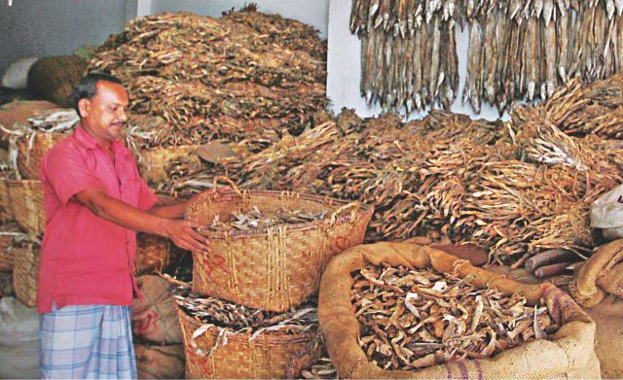
.
Dried Fish : The later one that means dried fish is used to make many dishes/salad/appetizers e.g. ‘Shutki Vorta’, ‘Begun-Shutki Torkari' etc.
Chittagong is famous for its SEAFOOD, with a variety of fish, prawns, and crabs available in the city's many restaurants and markets.
Bamboo Chicken is one of the most popular items in the menu and is also a favourite among the residents of Chittagong Hill Tracts. So much so, all the brands here, without any exception, have mentioned bamboo chicken or bamboo fish as a must-try item

Slide 36
Boisabi Utsab
The indigenous communities of the Chittagong Hill Tracts celebrate Boisabi Utsab, their biggest cultural festival.
This vibrant event marks the farewell to the past year and the welcoming of the new with various traditional festivities.
Different tribes have unique names for the festival—Biju (Chakma), Bishu (Tanchangya), Boisuk (Tripura), and Sangrai (Marma). The name Boisabi combines elements from these terms.
The three-day festival begins with Phul Biju, where people float flowers in rivers and springs, seeking blessings. The second day, Chaitra Sankranti, is the main celebration with traditional feasts, including the special Pachon curry.
The final day, Gojyapojya Din, coincides with the Bangla New Year.
In Rangamati, celebrations began with flowers floating in Kaptai Lake.
On the other hand, the Tripura community started their “Boisuk” festivities at Garjantali Ghat of Kaptai Lake in the morning, while in Khagrachhari, the Tripura community observed these rituals at the Chengi River. Traditional dances, songs, and festive gatherings marked the occasion.

Slide 37
Renowned Personality

Slide 38


Daulat Kazi
Daulat Kazi (c. 1600-1638) was a poet of medieval Bengali literature. He is believed to have been born in the Qazi clan of Sultanpur village in Raozan upazila of Chittagong.
Syed Waliullah
Syed Waliullah (August 15, 1922 – October 10, 1971) was a Bangladeshi novelist, short-story writer and playwright. He was notable for his debut novel, Lalsalu (translated in English with the title "Tree Without Roots"). He was awarded Bangla Academy Literary Award (1961), Adamjee Prize (1965), Ekushey Padak (1984) and Bangladesh National Film for Best Story (2001).

Slide 39






Famous Personality Of Chattogram Division
Munir Chowdhury
Sargent Jahurul Haque
Bir Sreshtho Ruhul Amin
Pritilota Waddedar
Salam Language Martyr
Novera ahmed

Slide 40


Ayuub Bacchu:
Ayuub Bacchu is one of the best guitarist, singer and composer in Bangladesh.
Bibi Russell
Bibi Russell is a Bangladeshi fashion designer and former international model.
Afzal Ali was a medieval Bengali poet. He is best known for his magnum opus, Nasihatnama. Abdul Karim Sahitya Bisharad claims that he belongs to 17th century.

Slide 41


Problems of Chattogram Division and solutions
The problem of waterlogging in Chittagong has reached such an extent that the first monsoon rain is enough to shut down the city.
Flood problem in the southern part of the division.
Crises of supply water and high salinity are commonplace in Chittagong city. Sometimes the water is so salty that the Wasa is forced to suspend its supply to different neighborhoods.
Chattogram is located near Myanmar and India boundaries. That is why they face many drug issues.
As Chattogram has many tourist places, tourism facilities should be more developed.
Chattogram port faces many problems to deliver the goods at the right time for these goods are rotten.
Climate Change impacts in Chittagong Hill Tracts:Indigenous communities, despite making up only 1.8% of the population, are disproportionately affected by climate change. They face land and crop losses, displacement, and higher risks of waterborne diseases. Social exclusion and limited access to basic rights further increase their vulnerability to climate-related disasters, threatening their livelihoods, health, and traditional cultural practices.

Slide 42
Sources:
Banglapedia & Wikipedia
https://en.banglapedia.org/index.php/Chittagong_Division
https://en.banglapedia.org/index.php/Chittagong_District
https://www.chittagongdiv.gov.bd/bn/site/page/eAuN
https://en.wikipedia.org/wiki/Chittagong
https://en.wikipedia.org/wiki/Tribal_peoples_of_Chittagong_Hill_Tracts#:~:text=It%20is%20the%20home%20of,live%20in%20harmony%20with%20nature
https://en.wikivoyage.org/wiki/Chittagong_Division
https://en.wikipedia.org/wiki/Names_of_Chittagong
https://www.thedailystar.net/op-ed/politics/the-%E2%80%9Csorrow-chittagong-city%E2%80%9D-105313
https://www.dhakatribune.com/bangladesh/nation/340751/chittagong-wasa-salinity-in-supply-water
https://documents1.worldbank.org/curated/pt/627571467997887013/pdf/IPP2800IPP0P101Draft0March026102008.pdf
Population and Housing Census 2022, National Report (Volum I)

